Slide 1
Step by step guide to create A Client Journey Map

Slide 2
Example of Client Journey Map

Slide 3
Client Profile

Slide 4
Client profile
Picture (whether real or anonymous)

Slide 5
Client profile
Add key demographic details

Slide 6
Title

Slide 7
Title
Be specific about what the topic/ system is

Slide 8
Key Impacts

Slide 9
Examples of Key Impacts
Highlight key factors that impact the person across time

Slide 10
Examples of Key Impacts
Highlight key factors that impact the person across time

Slide 11
Examples of Key Impacts
Highlight key factors that impact the person across time

Slide 12
Key

Slide 13
Key
Key for important symbols. These can be changed if needed!

Slide 14
Client journey

Slide 15
Client journey
Key client journey
Timeline can be broad or specific, and is encased by squares

Slide 16
Client experience map

Slide 17
Client experience map
Key for important symbols. These can be changed if needed to “cognitive load” or other reflections.
Don't forget to consult the person who you're writing about to understand their experience!

Slide 18
Create your own Client Journey Map

Slide 19
When printing:
Change paper size to A3

Slide 20
Client Profile (picture)
Picture (whether real or anonymous)

Slide 21
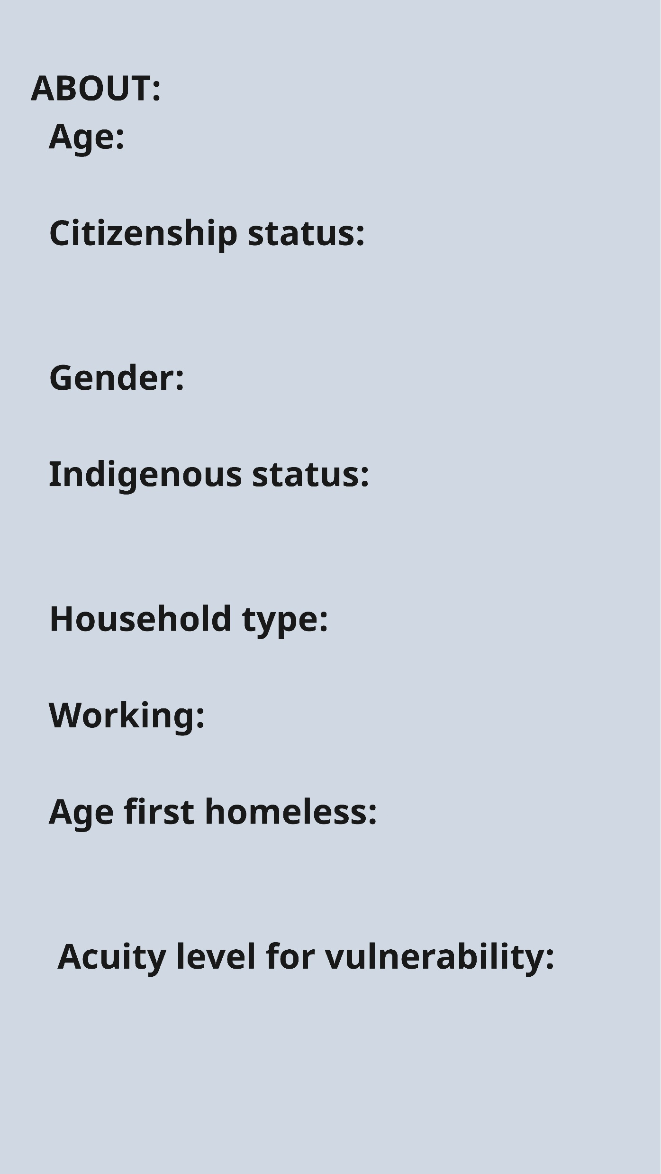
Client Profile
ENTER HERE
Add key demographic details
ENTER HERE
ENTER HERE
ENTER HERE
ENTER HERE
ENTER HERE
ENTER HERE
ENTER HERE

Slide 22
Key Impacts
Highlight key factors that impact the person across time
Can be as few/many as needed
CATEGORY OF IMPACTS
FACTOR #1
FACTOR #2
FACTOR #3
FACTOR #4
FACTOR #5
FACTOR #6

Slide 23
Client journey
EVENT
EVENT
EVENT
EVENT
EVENT
Connected event/outcome
Connected event/outcome
Connected event/outcome
Connected event/outcome
Connected event/outcome
Connected event/outcome
Connected event/outcome
Connected event/outcome
Connected event/outcome
Connected event/outcome
Connected event/outcome
Connected event/outcome
Connected event/outcome
Connected event/outcome
Connected event/outcome
Connected event/outcome
Connected event/outcome
Key client journey
Copy/paste the below icons as needed
Start Time Period – End Time Period
Start Time Period – End Time Period
Start Time Period – End Time Period
Timeline can be broad or specific, and is encased by squares

Slide 24
Client experience map
Key for important symbols. These can be changed if needed to “cognitive load” or other reflections.
EXPERIENCE
EXPERIENCE
EXPERIENCE
EXPERIENCE
EXPERIENCE
EXPERIENCE
EXPERIENCE
EXPERIENCE
EXPERIENCE
Don't forget to consult the person who you're writing about to understand their experience!
Can rate experience from 1 (lowest/worst) to 5 (highest/best)

